Slide 1
Strider Family Fiesta Post-event Report
Presented by: WIGU Marketing and Events Pte. Ltd
26 December 2019

Slide 2
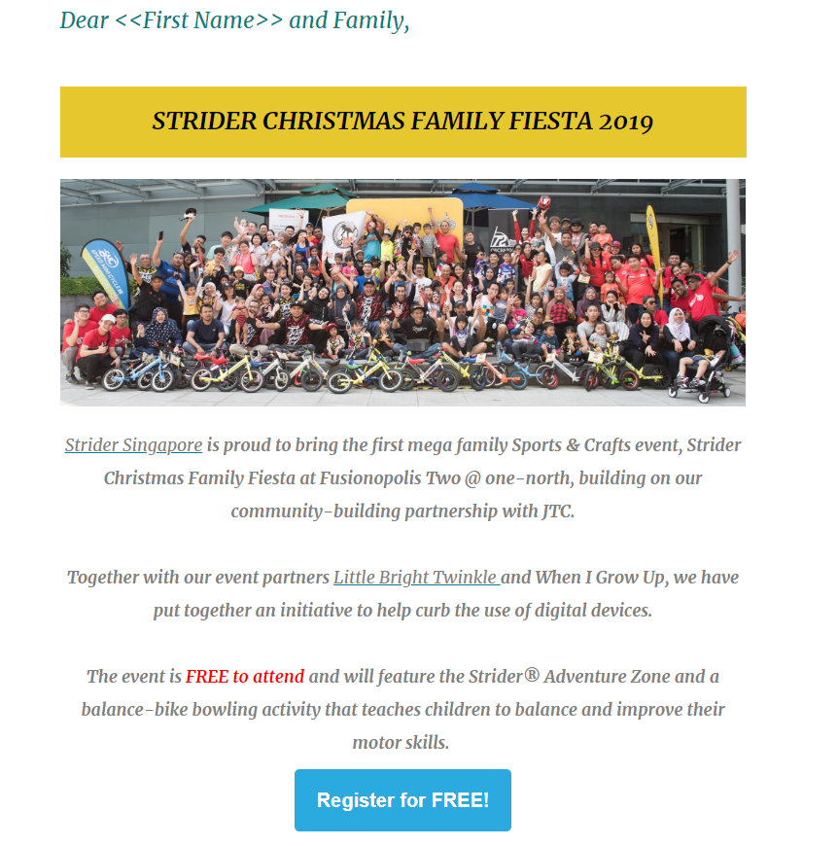
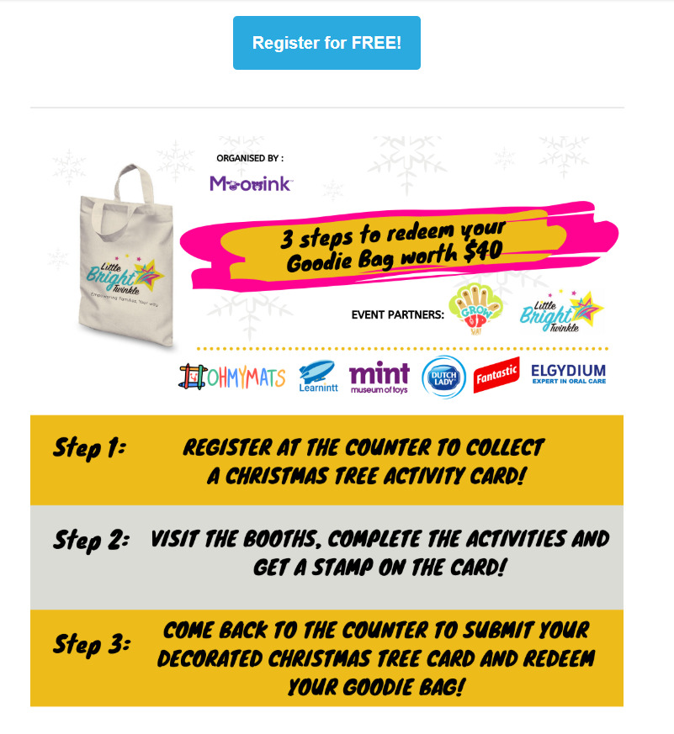
Pre-event collaterals - EDMs
Event EDMs disseminated to Strider’s, Little Bright Twinkle and Interracial Families Singapore’s database.
Sponsor’s logos featured here

Slide 3
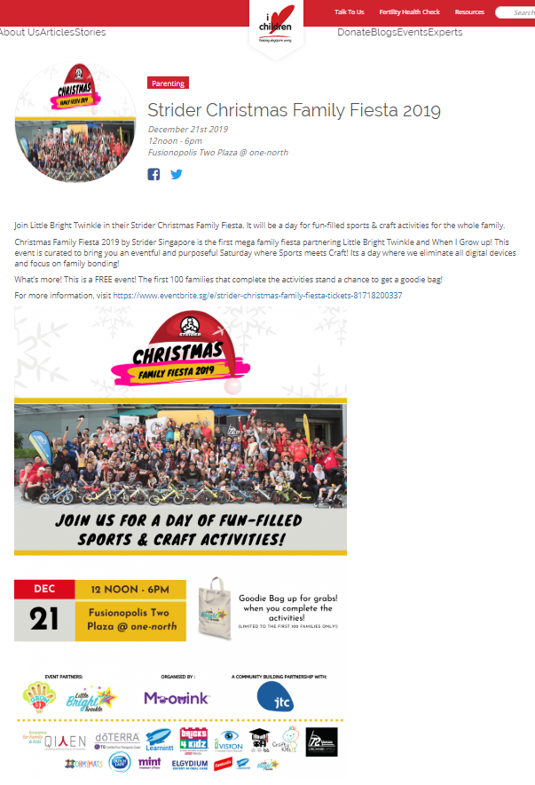
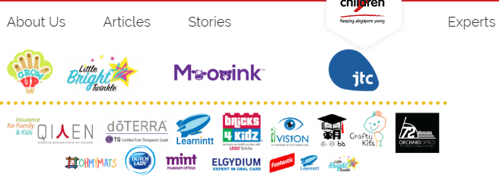
Pre-event collaterals – PR and Features
https://ilovechildren.sg/event/strider-christmas-family-fiesta-2019 - I Love Children
Sponsor’s logos

Slide 4
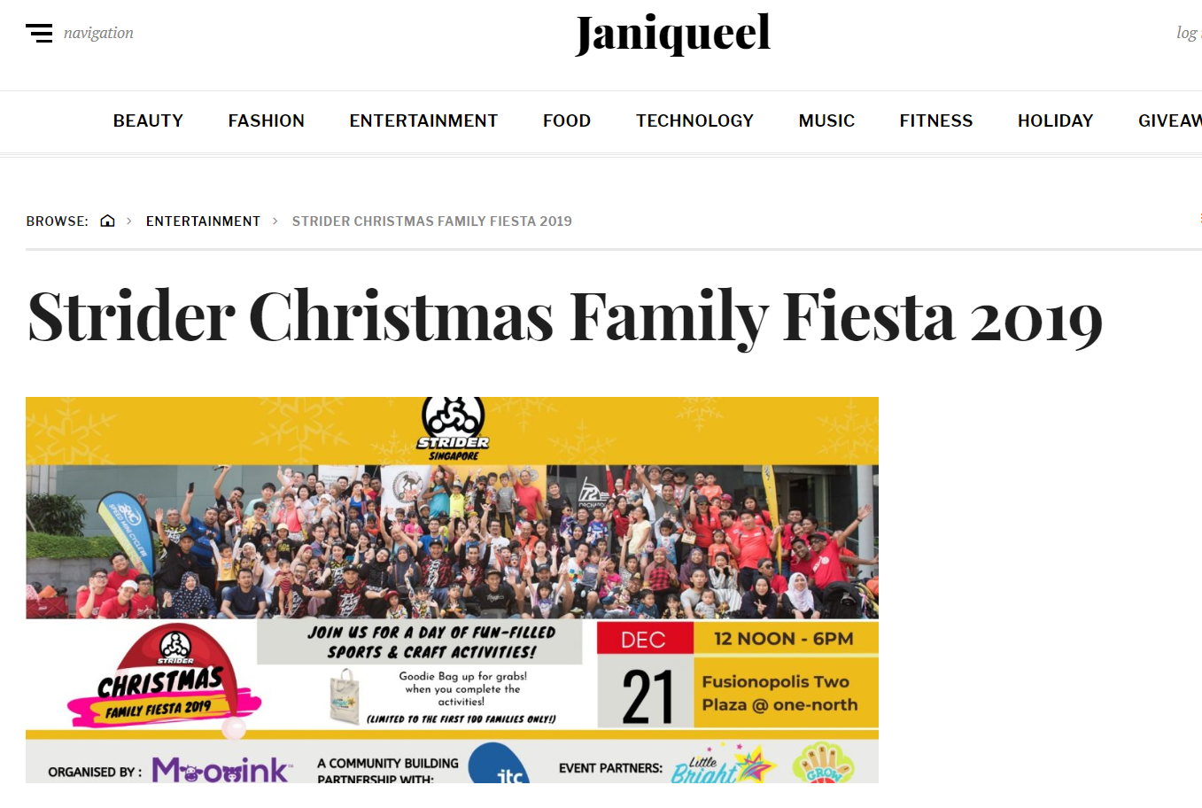
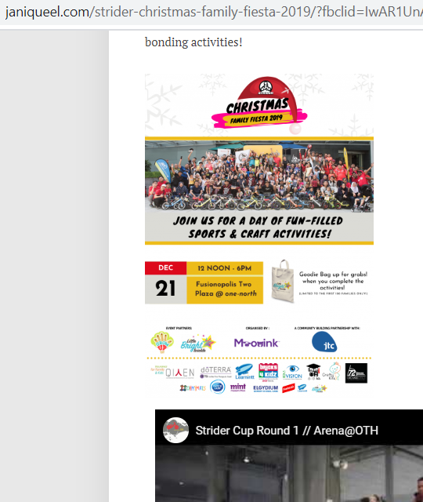
Pre-event collaterals – PR and Features
http://www.janiqueel.com/strider-christmas-family-fiesta-2019/?fbclid=IwAR1UnAPmt-aYAtYTxRn932XqLwOLmcGRhdGg3WpihNxMdWG9odFbg0Irn1U - Janiqueel

Slide 5
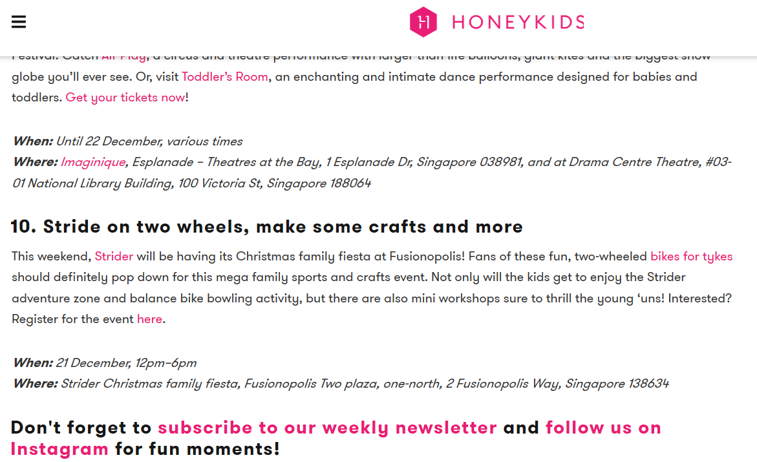
Pre-event collaterals – PR and Features
https://honeykidsasia.com/have-a-blast-at-striders-christmas-family-fiesta/ – Honey Kids Asia

Slide 6
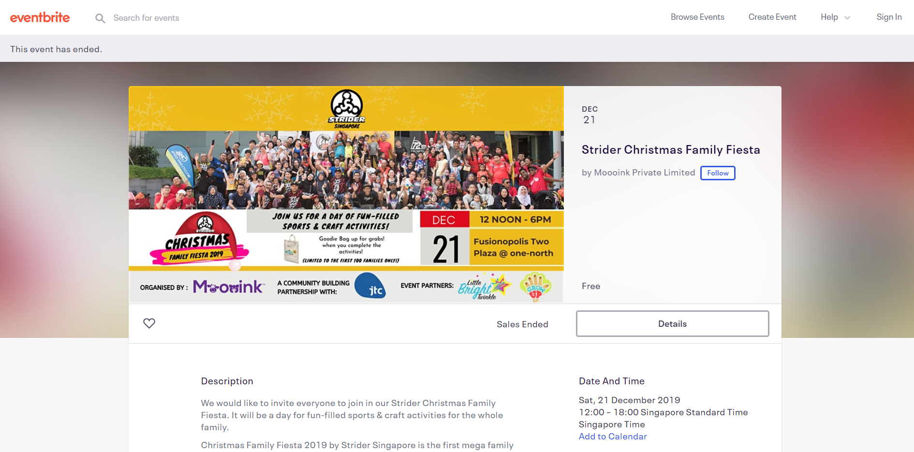
Pre-event collaterals - Listings
https://www.eventbrite.sg/e/strider-christmas-family-fiesta-tickets-81718200337# - Eventbrite

Slide 7
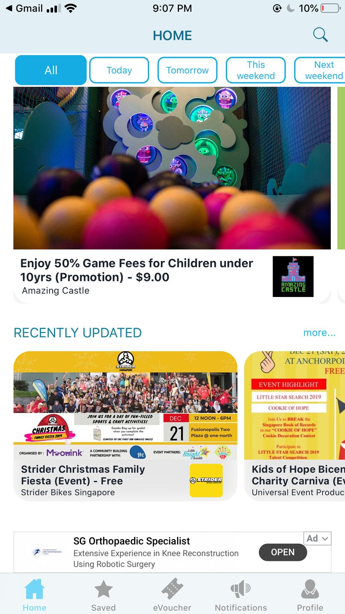
Pre-event collaterals – Listing
Listed on byKidO app

Slide 8
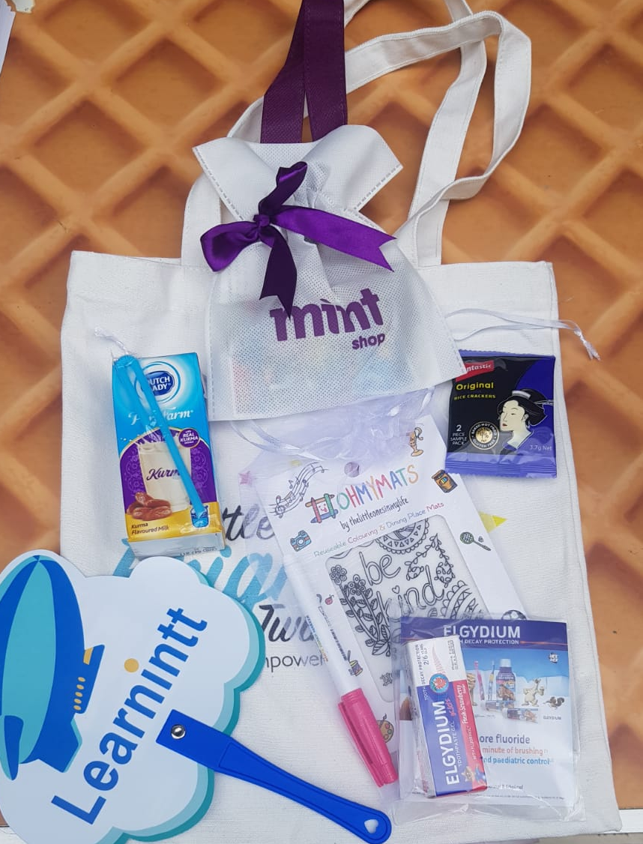
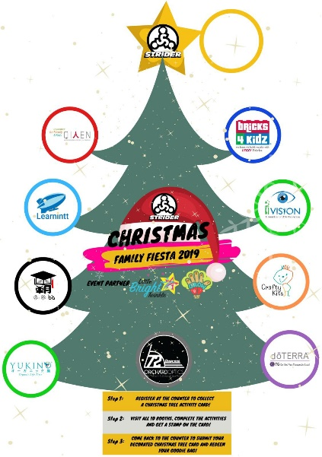
During Event
Goody bag inserts
Over 300+ parents attended.
10 fun activity booths presented by Strider, Qiren Organization, Learning in Transit, A*Speech, Yukino, Bricks 4 Kidz, SLM Visioncare, Crafty Kids, doTTEERA and 72 Degrees Optics.
Emcee Shutouts were made during the event to both activity vendors and goody bag sponsors.
Event Passports

Slide 9
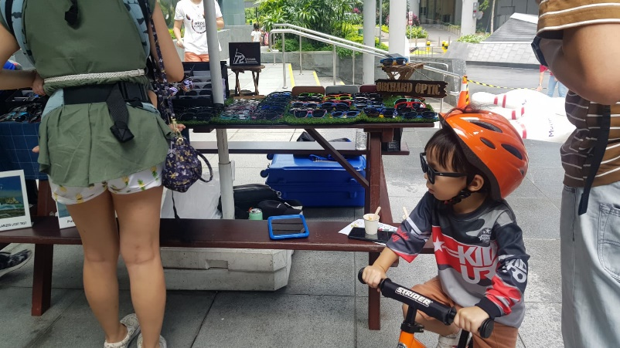
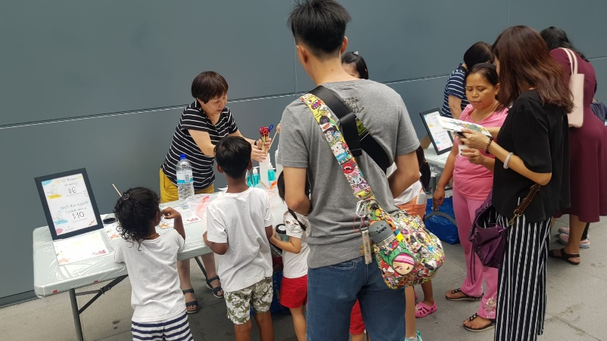
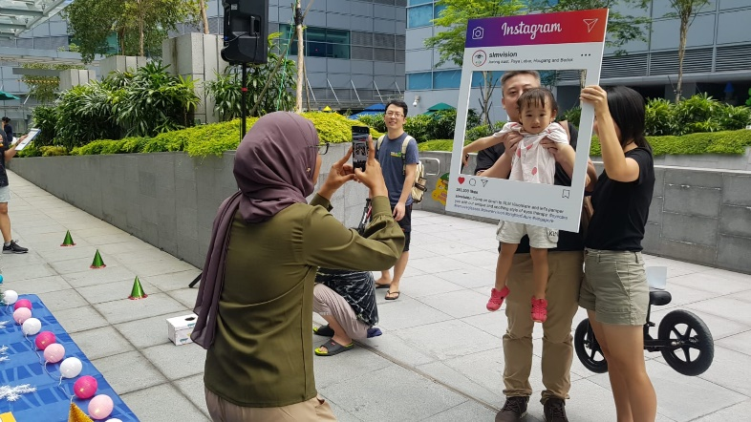
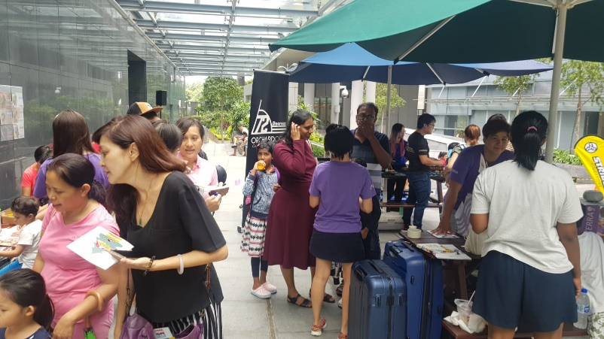
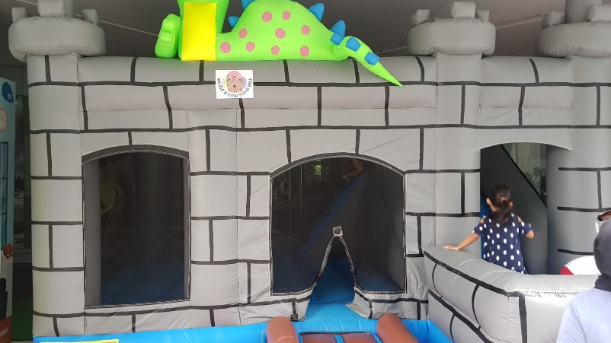
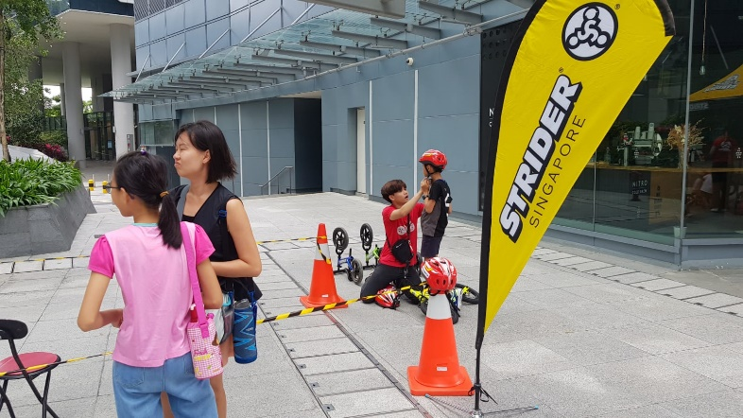
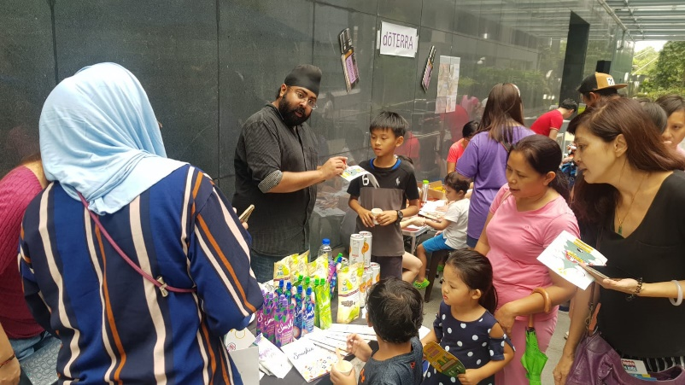
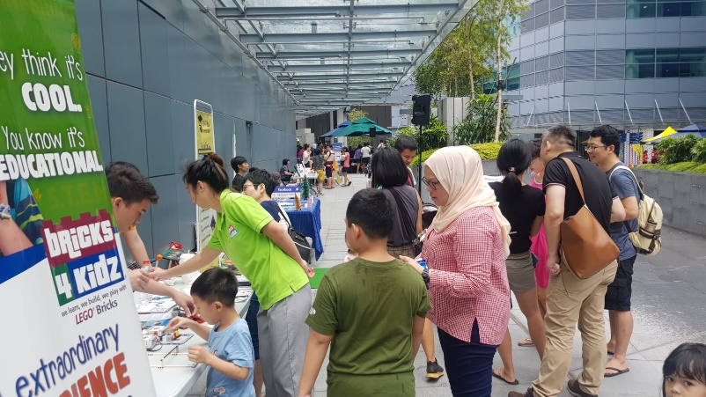
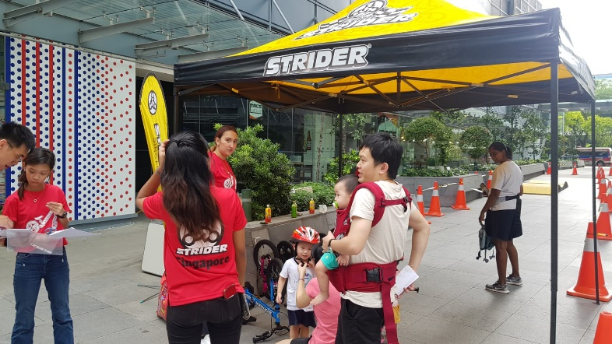

Slide 10
Thank you for your support!

